Slide 1

Radar System
Presented to: Dr. Ali AbdElAziz

Slide 2

Overview

Slide 3
Overview – Purpose
Our project aims to measure the speed of passing vehicles using light sensors and an Arduino/Raspberry Pi system.
We aim to provide a simple and cost-effective solution for measuring vehicle speed.
If the vehicle's speed exceeds a certain threshold, the system triggers an LED light to flash as a warning.
One potential use case of this system could be to warn the drivers when they approach the speed limits.
If scaled properly, this technology can be used to improve road safety and traffic flow by alerting drivers who are exceeding the speed limit.
Overall, the purpose of the project is to demonstrate the potential of low-cost and accessible technologies in addressing real-world problems related to road safety and traffic management.

Slide 4
Overview – Operation
The project utilizes two light sensors placed at a certain distance from each other to measure the time taken by a vehicle to travel the distance.
By calculating the time taken to travel the distance, the system can determine the speed of the vehicle.
When a vehicle passes the first sensor, it triggers a timer to start counting.
When the vehicle passes the second sensor, the timer stops and calculates the time taken for the vehicle to travel the distance.
By dividing the distance by the time, the system can calculate the speed of the vehicle.
If the speed exceeds a certain threshold, the system triggers an LED light to flash as a sample response.

Slide 5
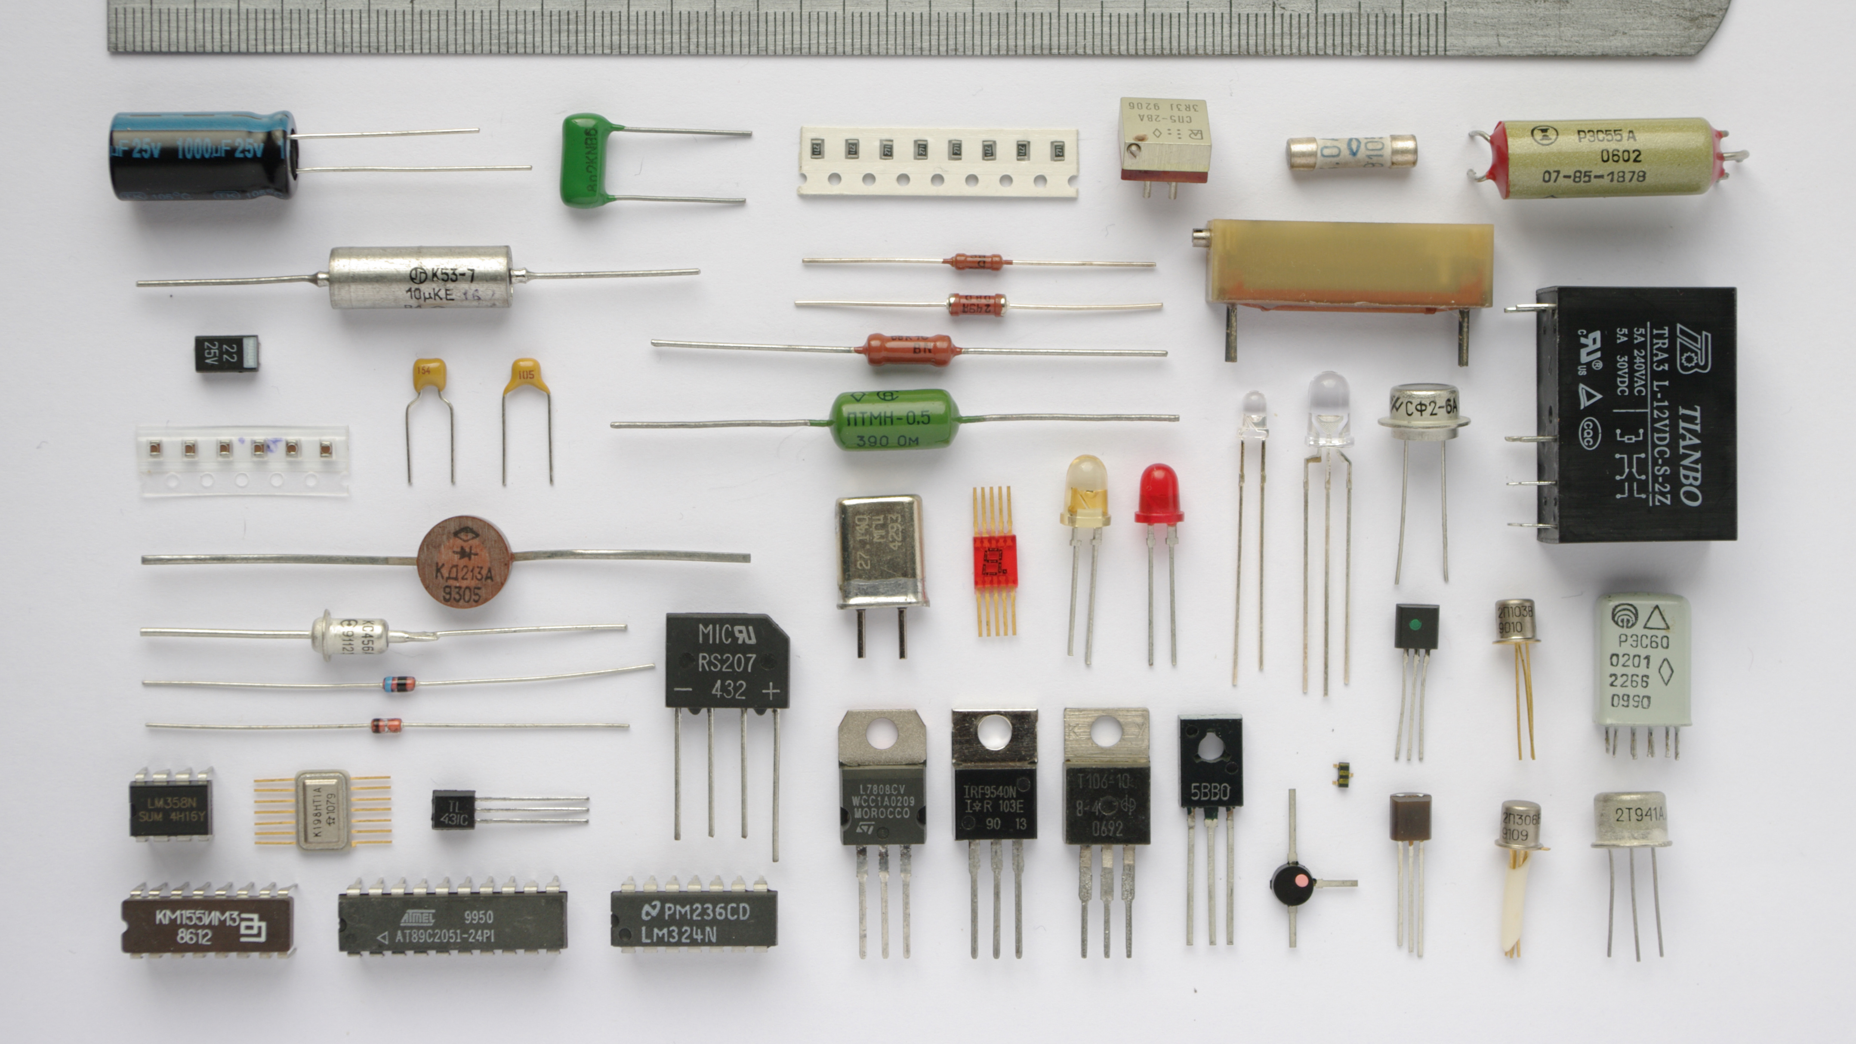
Components Used
This Photo by Unknown author is licensed under CC BY-SA-NC.

Slide 6
Components Used
Arduino Nano
Raspberry Pi 3B+
IR sensor
Buck circuit
Breadboard
3 LEDs
Male and female wires for connection

Slide 7
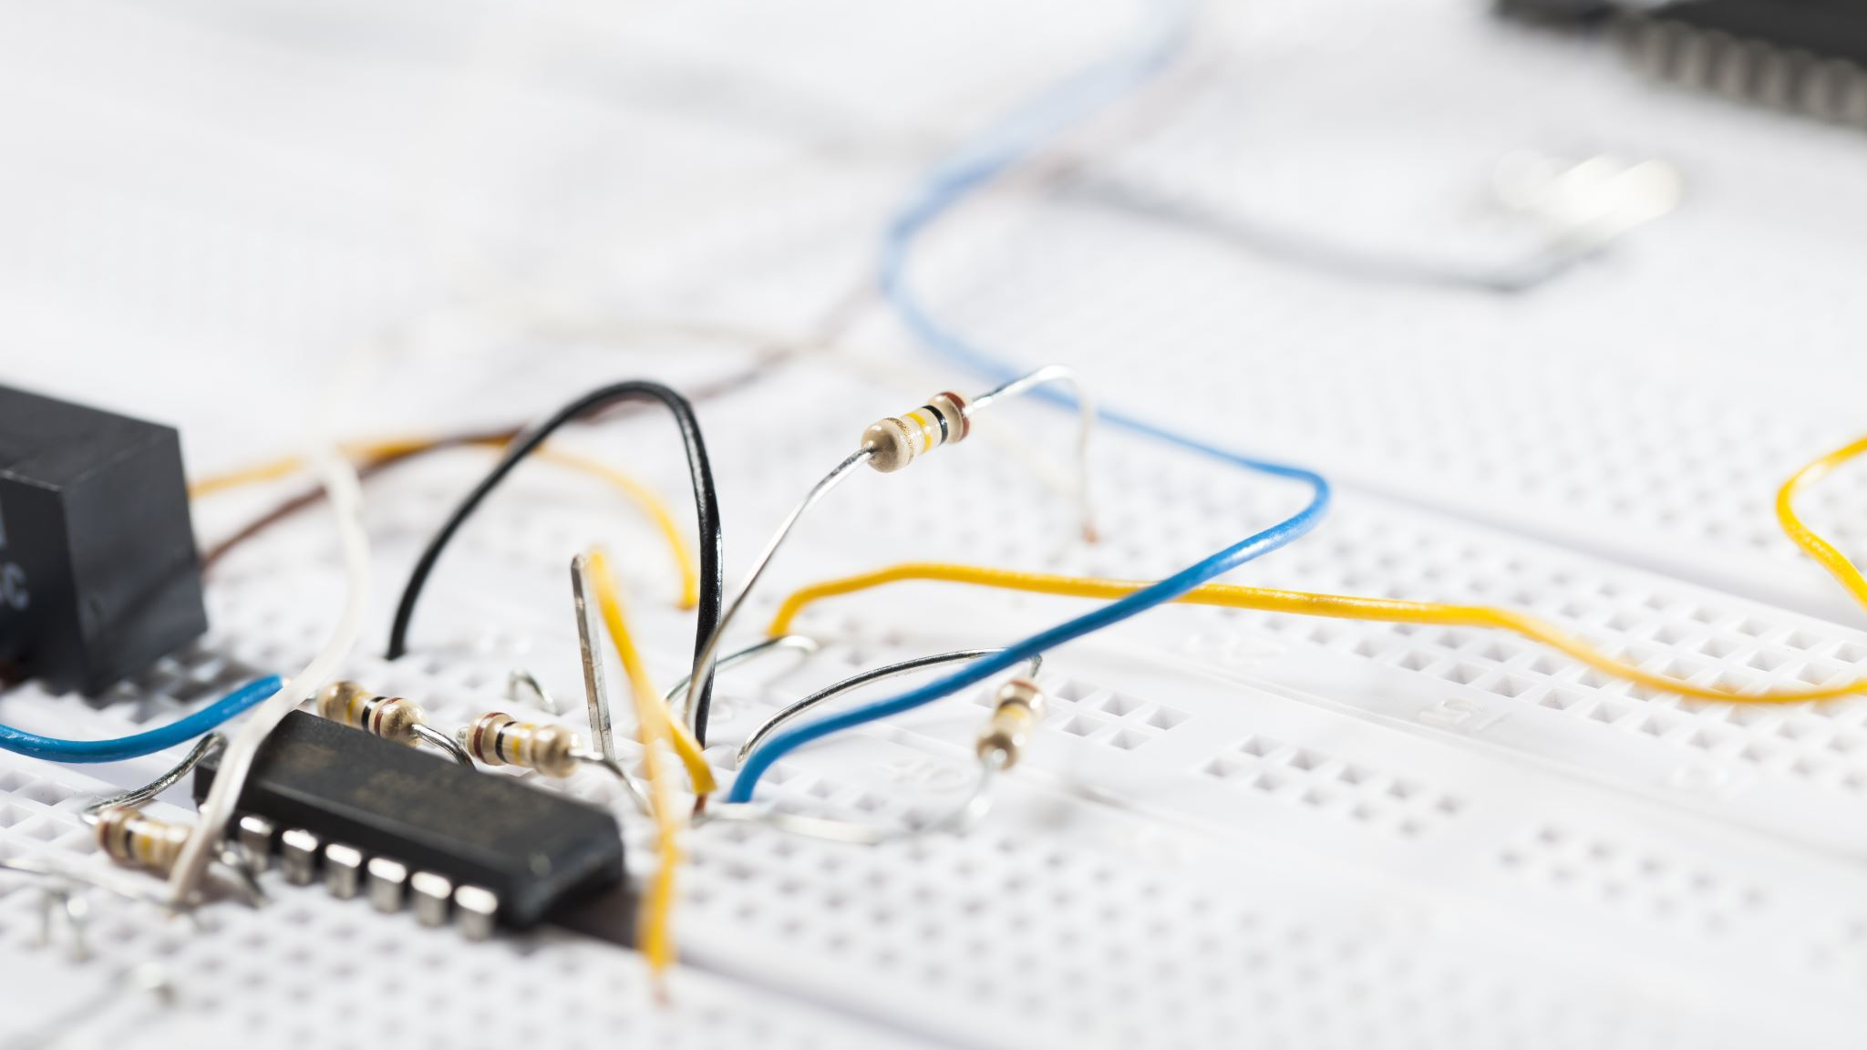
Circuit

Slide 8
Circuit

Slide 9

Programming

Slide 10
Programming

Slide 11

Decisions and Tradeoffs

Slide 12
Decisions and Tradeoffs
We decided to use the Arduino Nano for input because it is a small and inexpensive microcontroller board that can handle the task of reading sensor inputs and performing calculations quickly and efficiently.
The Arduino Nano is specifically designed for input/output (I/O) operations and has built-in analog-to-digital converters (ADCs) that allow it to read analog signals from the light sensors.
The Raspberry Pi is able to perform more complex calculations and store larger amounts of data, making it a better choice for output operations like triggering the LED light when the vehicle's speed exceeds the threshold.
Overall, the decision to use the Arduino Nano for input and the Raspberry Pi for output was a tradeoff between processing power and cost, and it allowed us to create a system that balances these factors while still providing accurate and reliable results

